Slide 1
The Sports Authority and Gart Sports Company
Company data and merger information

Slide 2
The August, 2003 “merger of equals” of The Sports Authority (TSA) and Gart Sports Company (GRTS)⁽¹⁾ created a national sporting goods retailer with:
    387 stores in 45 states—182 Gart stores and 205 TSA stores
    Combined 2002 sales of $2.5 billion
    Estimated pre-tax synergies over $20 million in FY 2004, $40 million in FY 2005 and $50 million thereafter
    6 distribution centers in Denver, Fontana, CA, Houston, Atlanta, Woodbridge, IL and New Jersey
    Potential for expanding premium brands and private labels into all stores
    Plans to open 20 new stores in 2003 and 20 new stores in 2004
    Plans to grow the combined company’s square footage base by 5% net annually during the next 3 years
    Plans to leverage TSA’s expertise in hardlines and athletic apparel and Gart’s expertise in outdoor and winter apparel
(1) Gart Sports Company acquired Sportmart in 1/1998 and Oshman’s in 6/2001
(2) A joint venture with AEON, Ltd. Operates 43 TSA stores in Japan under a licensing agreement
Source: Sports Authority 2001 Annual Report , Gart Sports Company 10K for fiscal year ending February 1, 2003 (Data not available for Gart FY 1997 and TSA FY 2002); FD(Fair Disclosure Wire) February, 2003; Sports Authority website “Profile.”

Slide 3
The Sports Authority and Gart Sports Company have comparable store numbers and store size, target audiences and merchandise. They have complementary geographic focus
Sports Authority
As of September 25, 2003, operated 198 stores in 33 states; Joint venture with AEON, Ltd. operates 43 TSA stores in Japan under a licensing agreement
Largest full-line sporting goods retailer
Geographically focused on the east coast
Cater to everyday athletes and sports enthusiasts
Stores are 35,000 – 45,000 square feet
Starting in 2000, undergoing extensive store remodeling from a warehouse to a “specialty store-within-a-store” format – expected completion in all stores by 2005
Average of 40,000 SKUs
Merchandise includes:
  52% hardlines⁽¹⁾
  48% softlines⁽²⁾ - 23% apparel and 25% footwear
Gart Sports Company
As of September 25, 2003, operated 183 stores in 25 states (Includes Gart Sports, Sportmart and Oshman’s stores)
Geographically focused on the west coast
Cater to everyday athletes and sports enthusiasts
Superstores are 30,000 – 45,000 sq.ft.; non-superstores are 18,000 sq.ft.; shopping mall stores are 15,000 sq.ft.
Undergoing remodeling in some Gart & Sportmart stores & all Oshman’s stores – expected completion by 2006
Average of 125,000 SKUs
Merchandise includes:
  51.2% Hardlines
  48.8% Softlines – 26.7% apparel and 22.1% footwear
  Focused on winter sports equipment, apparel and rental – especially skiing and snowboarding
Hardlines include: Equipment for team sports, fitness, outdoor sports, golf, racquet sports, cycling, water sports, marine, snow sports & general merchandise
Softlines include: Athletic and active footwear and apparel

Slide 4


Before The Sports Authority and Gart Sports Company merged in August, 2003, each company had been a party to either previous acquisitions or joint ventures
November, 1994
TSA is spun off from parent company, Kmart, which had acquired TSA in 1990
January, 1995
TSA enters into a Joint Venture with JUSCO Co., Ltd., a major Japanese retailer to operate TSA stores in Japan through a jointly owned Japanese corporation, Mega Sports
January, 1998
Gart acquires Sportmart – Increased store base by 59 stores and expanded to 8 additional states
August, 1998
TSA rejects GRTS’s merger proposal to acquire 70% of TSA for $14 per share in cash, plus 51% of the shares of the combined entity
March, 1999
Restructuring of TSA/JUSCO (now AEON) joint venture; TSA now has 19% share in Mega Sports, compared to 51% in 1995
Gart acquires Oshman’s – Increased store base by 58 stores and expanded to 9 additional states
June, 2001
TSA and GRTS finalize “merger of equals”
August, 2003

Slide 5
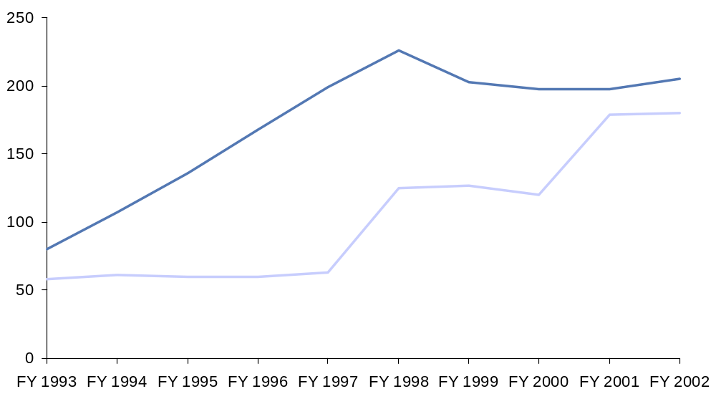
With the acquisition of Sportmart and Oshman’s, Gart Sports Company has increased its total number of stores to a level comparable to The Sports Authority
Total Number of Stores
Fiscal Years 1993-2002
The Sports Authority
Gart Sports Company
Units
Acquisition of Sportmart
Acquisition of Oshman’s
Source: Sports Authority Annual Reports, Gart Sports Company Annual Reports

Slide 6
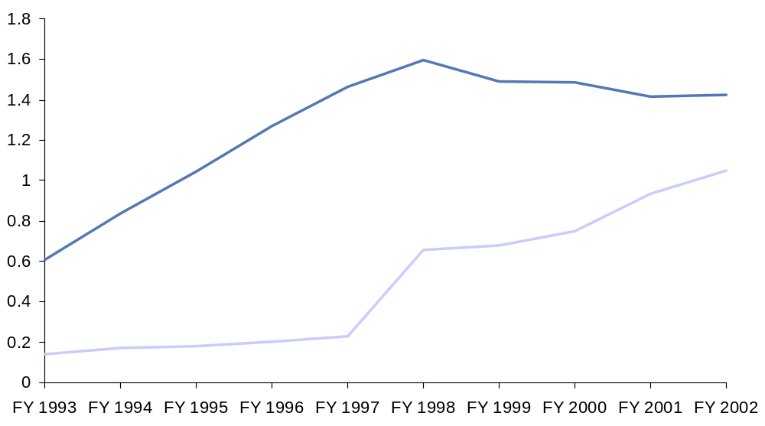
In the past 5 years, Gart Sports Company has been closing the gap in total sales with The Sports Authority
Total Sales
Fiscal Years 1993-2002
The Sports Authority
Gart Sports Company
Dollars (Billions)
Acquisition of Oshman’s
Acquisition of Sportmart
Source: Sports Authority Annual Reports, Gart Sports Company Annual Reports

Slide 7
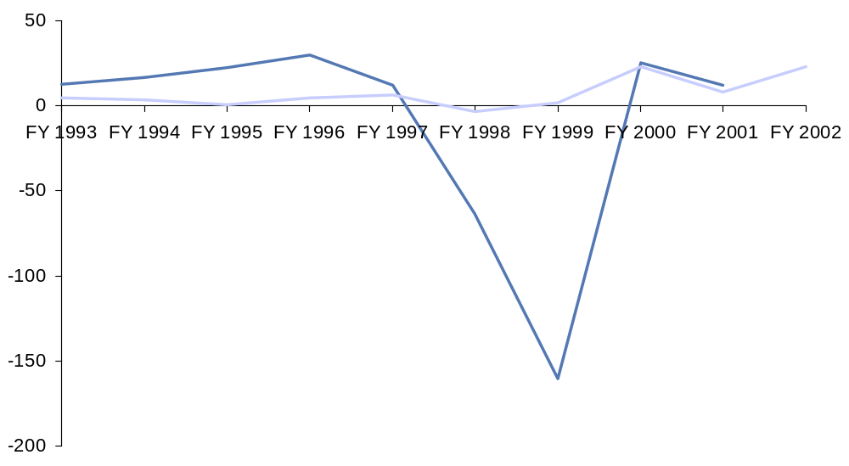
Net income has fluctuated from FY1993 to FY2002 at both
The Sports Authority and Gart Sports Company
Net Income
Fiscal Years 1993-2002
The Sports Authority
Gart acquires Sportmart
Gart Sports Company
Gart acquires Oshman’s
Dollars (Millions)
Source: Sports Authority Annual Reports, Gart Sports Company Annual Reports

